Slide 1
Project Plan and information plan website
Website : Milena’s Home
RASTAD Milena Erasmus Student April 2022

Slide 2
Project Definition

Slide 3
Purpose of the website « Milena’s Home »
The purpose of this project is to attract people to come to this restaurant.
I espect visitors getting information of the restaurant. They are probably going to have a look at the menu and the prices. To know their way to the restaurant they are going to land on the contact page. If they are satisfied with what the website has provided to them, they will make an online reservation.

Slide 4
Unique selling proposition
What makes it unique is that dishes such as pizzas,pasta,hamburgers for example are gluten-free. So customer coming to this restaurant can be gluten-free allergic without any problem.
The dishes are made with ingredients of the local market, fresh fish every day for example.
You can make an online reservation for a table. The restaurant is open a long period during the day.

Slide 5
Description of the target group
People of all ages are welcome in this restaurant.
People having gluten allergies are the main target.
People wanting to spend a good meal with family or friends in a non “industrial” restaurant.
People wanting to eat local/fresh products
I have created Emilie and Gaston who could possibly be frequent guests at Milena’s Home.

Slide 6
Persona
Name : Emilie
Name : Emilie
Bio :
Sex : Women
Emilie is a teenager enjoying her life. She cares a lot about her friends and like to go to restaurants with them
Age : 16 years old
Status : Single
Goals in context :
Interests :
Profession : None
Emilie saves money to be able to go to the restaurant with her friends.
Emilie would like to work in a restaurant as a chief. She enjoys tasting new recipies.
Locatie : Toulon, France
Frustrations in context :
Preferred channels :
Emile is allergic to gluten. She always takes salads in restaurants, but she would be able to eat pizzas or hamburgers like the others.
Emilie likes to make reservations online. She does not like to phone to have informations and make reservations

Slide 7
Persona
Name : Gaston
Name : Gaston
Bio :
Sex : Men
Gaston is an Engineer. He works a lot to provide a good life for his family. He has two kids and is married.
Age : 46 years old
Status : Taken
Goals in context :
Interests :
Profession : Engineer
Gaston is very busy but try to find the time to go to some restaurants with his family
Gaston is happy having once a good meal at a restaurant surrounded by his family.
Locatie : La Cadière, France
Frustrations in context :
Preferred channels :
Gaston wants to find a restaurant near where he lives. He also needs a restaurant where his kids can eat some local products.
Gaston like to surf on the internet to find a restaurant. He like to have clear and straight informations about the restaurant and what they serve.

Slide 8
Landing Page

Slide 9
Project Plan Informations

Slide 10
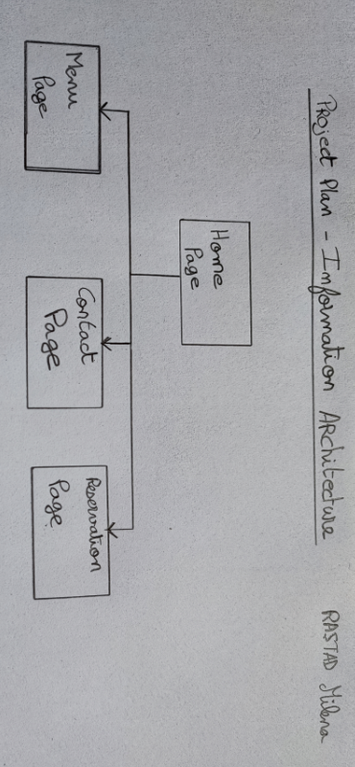

Slide 11
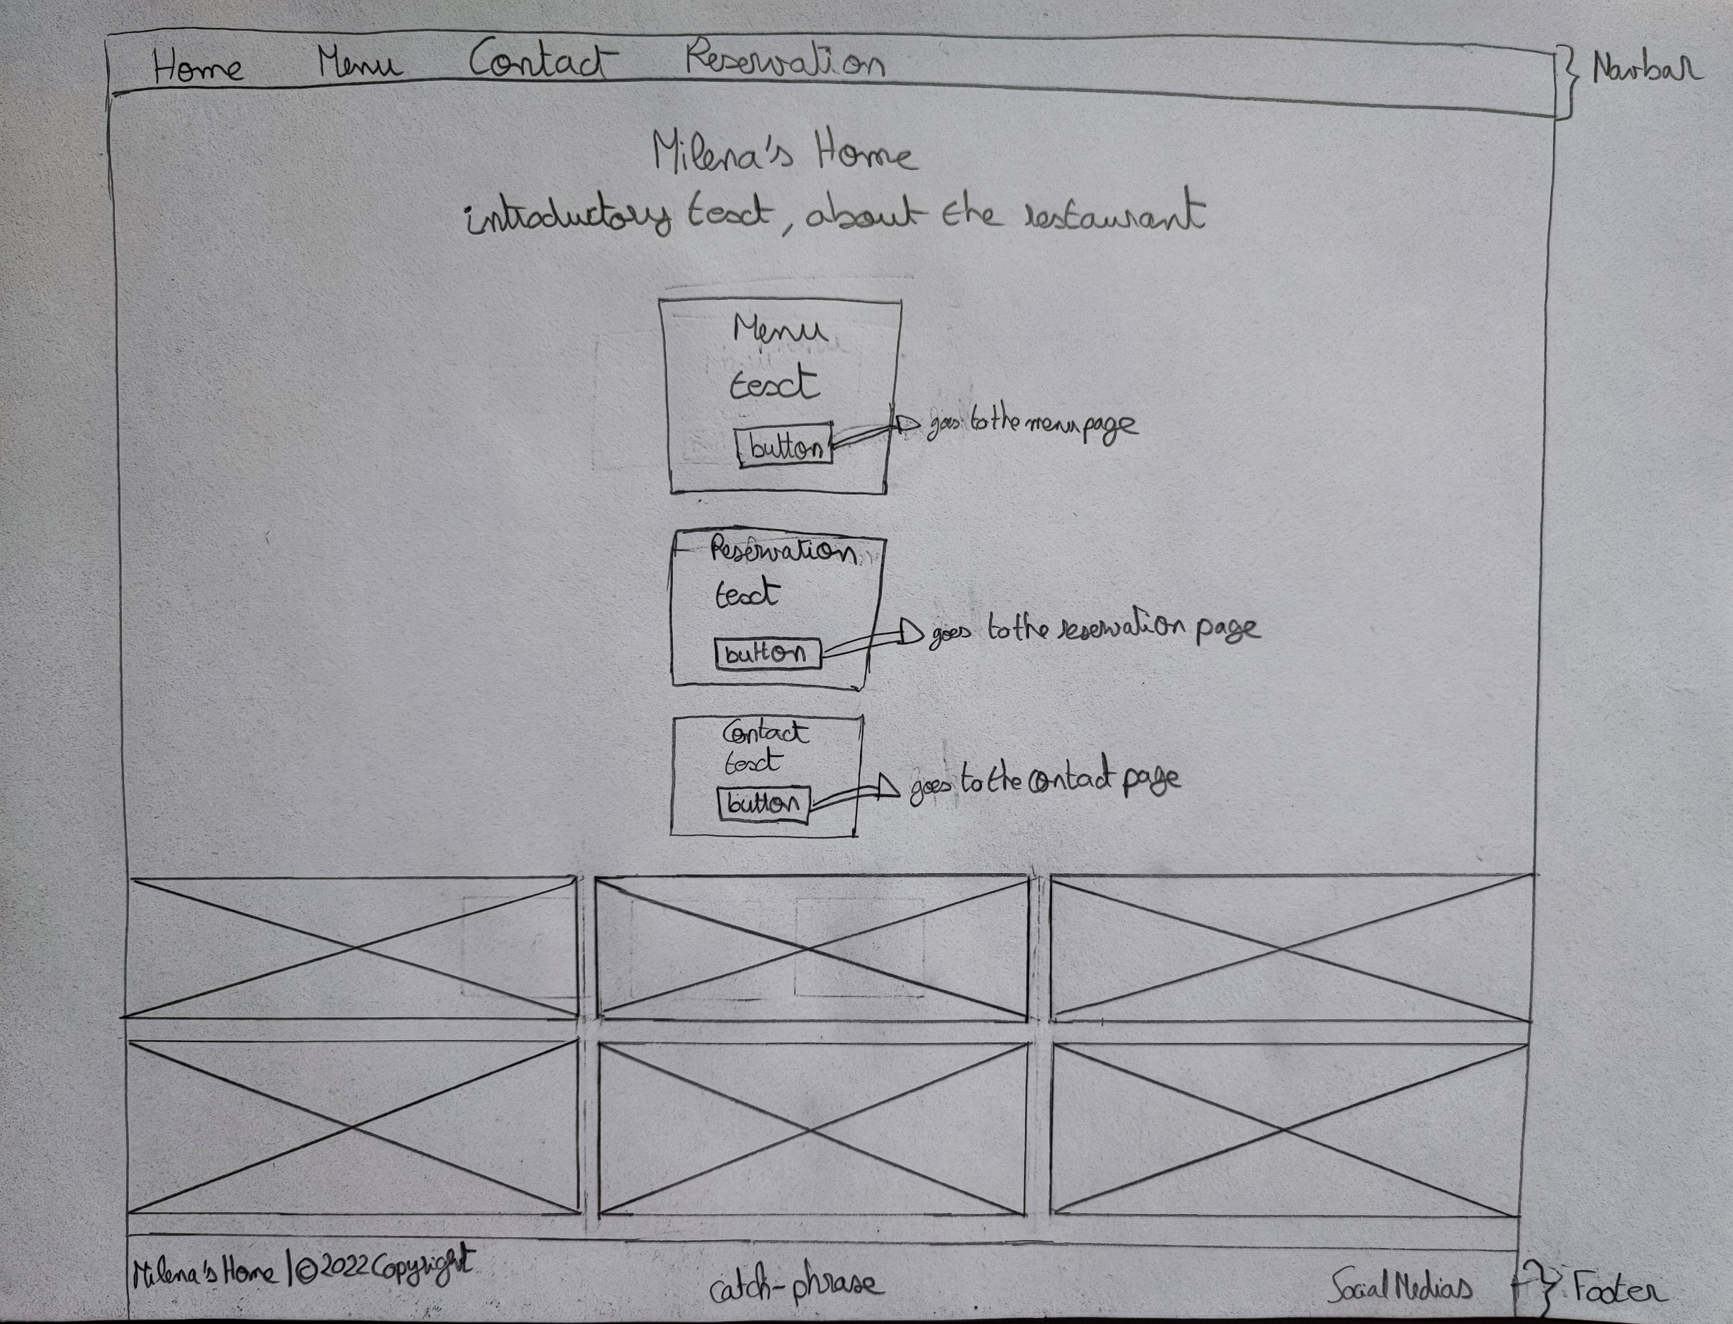
Home Page - Wireframe

Slide 12
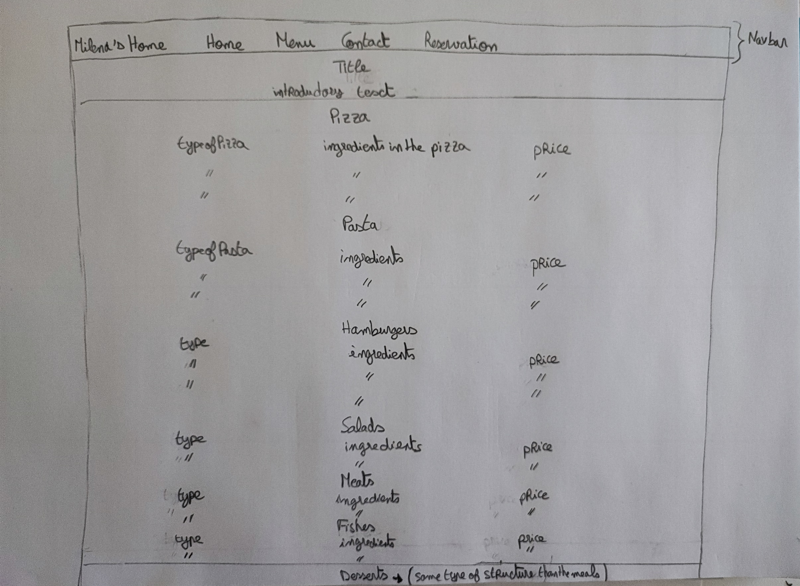
Menu Page - Wireframe

Slide 13
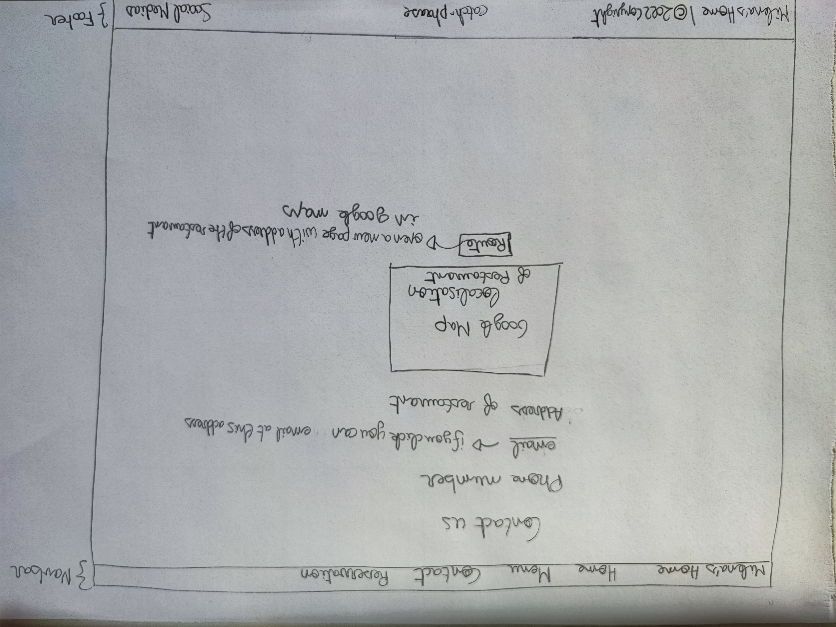
Contact Page - Wireframe

Slide 14
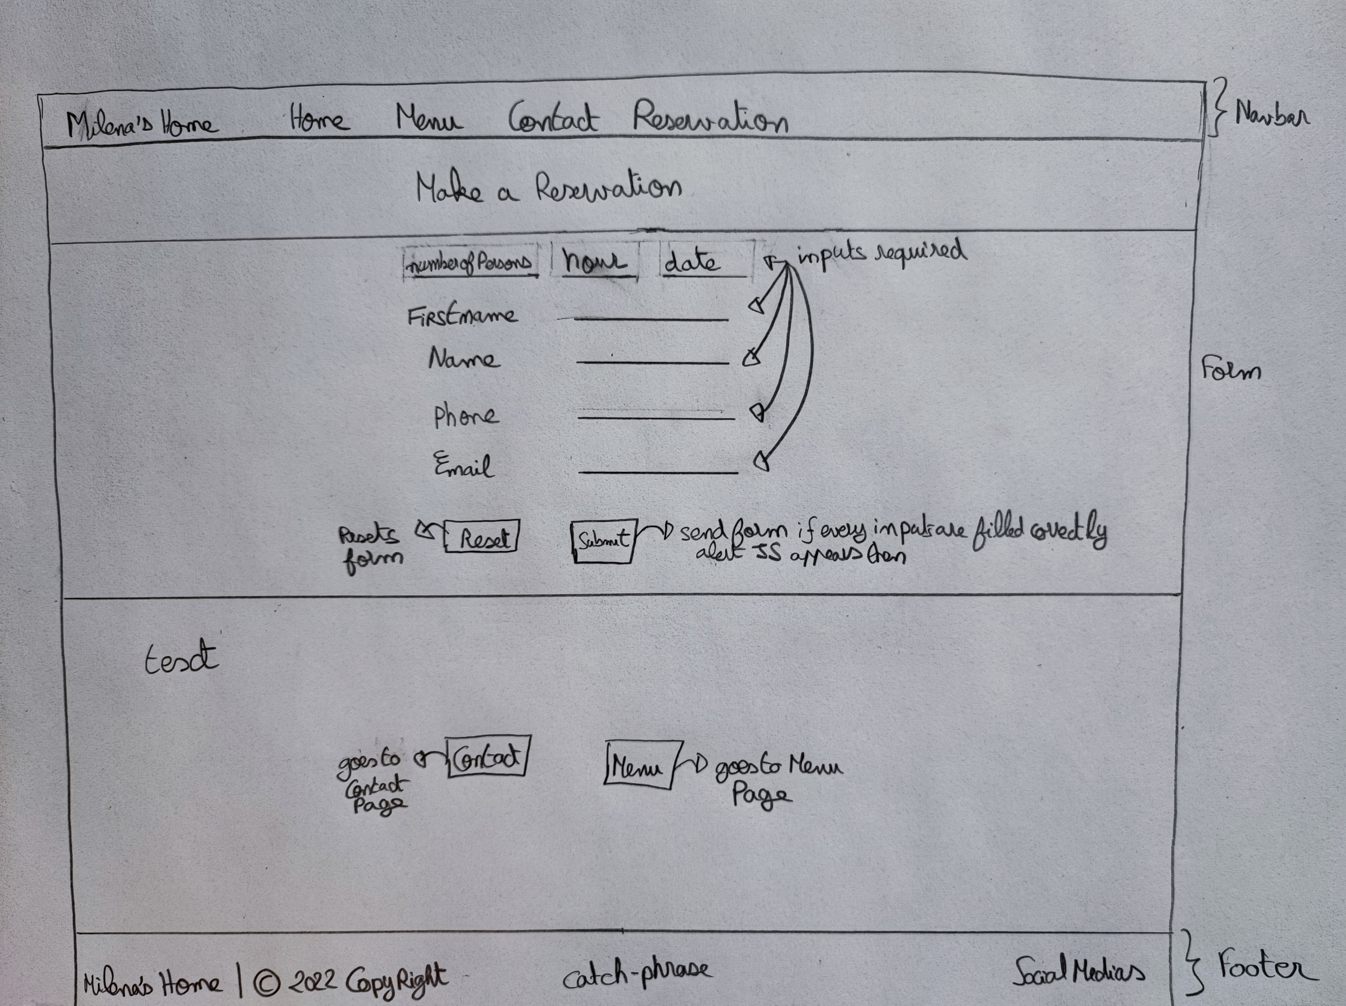
Reservation Page - Wireframe

